Slide 1
Cumulative Case Ratio
Described in the paper by Zinszer et al 2014
Weber Liu, for the MD project

Slide 2

General formula
$$CCR=\frac{Cases_{observed}}{Cases_{expected}}$$
$$Cases_{expected}=Pop_{ward}×Case Rate$$

Slide 3
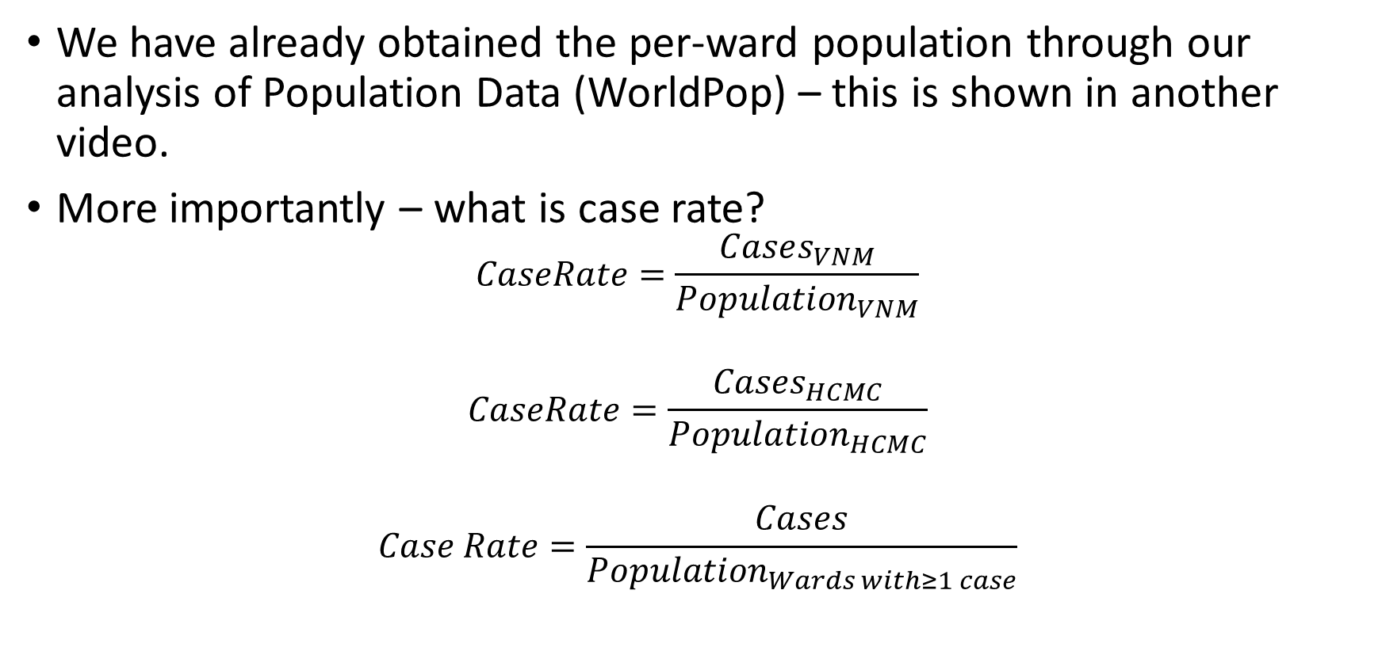
Part 1: ${Cases}_{expected}=Pop_{ward}×Case Rate$
We have already obtained the per-ward population through our analysis of Population Data (WorldPop) – this is shown in another video.
More importantly – what is case rate?
$$CaseRate=\frac{Cases_{VNM}}{Population_{VNM}}$$
$$CaseRate=\frac{Cases_{HCMC}}{Population_{HCMC}}$$
$$Case Rate=\frac{Cases}{Population_{Wards with≥1 case}}$$

Slide 4
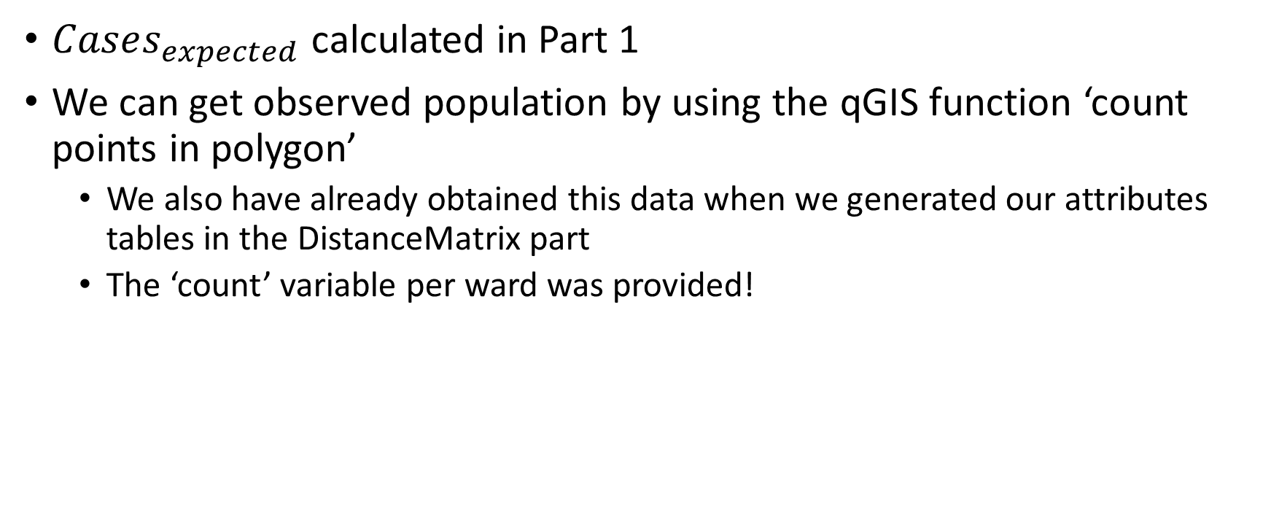

Part 2:$CCR=\frac{Cases_{observed}}{Cases_{expected}}$
$Cases_{expected}$ calculated in Part 1
We can get observed population by using the qGIS function ‘count points in polygon’
We also have already obtained this data when we generated our attributes tables in the DistanceMatrix part
The ‘count’ variable per ward was provided!

Slide 5

Step 3: Determining if the ward is included in the catchment
If $CCR≥1$, then the ward is included in the catchment
This implies we have more presentations than expected
The original paper describes the inclusion criteria as if the upper limit of the 95% confidence interval of $CCR≥1$, then it is to be included

Slide 6
Step 4: Map generation
As performed in the previous videos!

